Slide 1


WEEKEND WORKSHOP SERIES 3
Saturday
Google Cloud Architect Project
A hands-on, simple cloud simulation designed for Google Cloud PCA candidates to map, deploy, and evaluate real-world infrastructure.

Slide 2
Chiho Sharp
GOOGLE CLOUD CERTIFICATIONS
verified_user
stars
school
PROFESSIONAL
Professional Cloud Architect
CERT-P-CA
ACTIVE DATE
2026-06-11
EXPIRY DATE
2028-07-11
SERIES ID: 123792
ASSOCIATE
Associate Cloud Engineer
CERT-A-ACE
ACTIVE DATE
2025-10-30
EXPIRY DATE
2028-11-30
SERIES ID: 183505
FOUNDATIONAL
Cloud Digital Leader
CERT-FUN-CDL
ACTIVE DATE
2025-03-31
EXPIRY DATE
2028-04-30
SERIES ID: 95438

Slide 3

PROJECT SCENARIO
Build a Community Event Feedback Application
The Challenge
You client needs your help build a scalable feedback app using Google Cloud Services.
You will architect and deploy this solution using Cloud Run and Firestore.
Notes:
If you're using the latest Google Cloud Console
Be aware that Google has been encouraging users to host static websites behind services such as Cloud Load Balancing or Firebase Hosting for production environments. However, Cloud Storage static website hosting is still perfectly suitable for learning and is one of the easiest ways to introduce Cloud Storage, buckets, IAM, and object permissions in a beginner workshop.
For a Google Cloud Digital Leader or Associate Cloud Engineer class, this remains an excellent first hands-on lab.

Slide 4
Workshop Objectives
By the end of this session, you should be able to explain:
Google Cloud Concepts
Architecture Concept
What a Google Cloud project is
What a managed service is
What serverless means
What Cloud Run does
What a database does
What Firestore is
What an API is
How an application communicates with a database
Basic IAM/service identity concepts
Basic scalability concepts
A user sends a request to Cloud Run.
Cloud Run runs the application.
The application sends the feedback to Firestore, where it is stored as data.

Slide 5

A Google Cloud project is like a container that holds the resources for an application.
PROJECT CONTAINER (For example:)
cloud
Cloud Run
storage
Firestore
api
APIs
security
IAM
payment
Billing
It means they are all separate and independent.

Slide 6
Interactive Workshop
Let’s build it!
Plan and Map
USER
│
▼
┌─────────────────┐
│ Cloud Run │
│ Web Application│
└────────┬────────┘
│
▼
┌─────────────────┐
│ Firestore │
│ Database │
└─────────────────┘
Cloud Run runs the web application, while Firestore stores the feedback. Firestore is a serverless NoSQL database designed for applications that need automatic scaling.
Notes:
Part 1 – Create a Google Cloud Project (10 minutes)
Step 1
Go to
Google Cloud Console
Sign in with your Google account.

Slide 7
The Final Application
You will build something like this:
-----------------------------------------
COMMUNITY EVENT FEEDBACK
-----------------------------------------
Thank you for attending our event!
Name:
[____________________________]
Which event did you attend?
[ Summer Fair ▼ ]
How would you rate the event?
○ 1 ○ 2 ○ 3 ○ 4 ○ 5
Your feedback:
[____________________________]
[____________________________]
[____________________________]
[ SUBMIT FEEDBACK ]
Frontend
After submission:
Thank you, Sarah!
Your feedback has been submitted.
The information will appear in Firestore.

Slide 8
Collection
│
└── feedback
│
├── Document
│
├── Document
│
└── Document
feedback
│
├── document 1
│ ├── name: Sarah
│ ├── event: Summer Fair
│ ├── rating: 5
│ └── comment: Great event!
│
├── document 2
│ ├── name: James
│ ├── event: Table Tennis
│ ├── rating: 4
│ └── comment: Really enjoyable.
Firestore automatically generates document IDs when you add documents without specifying an ID.

Slide 9
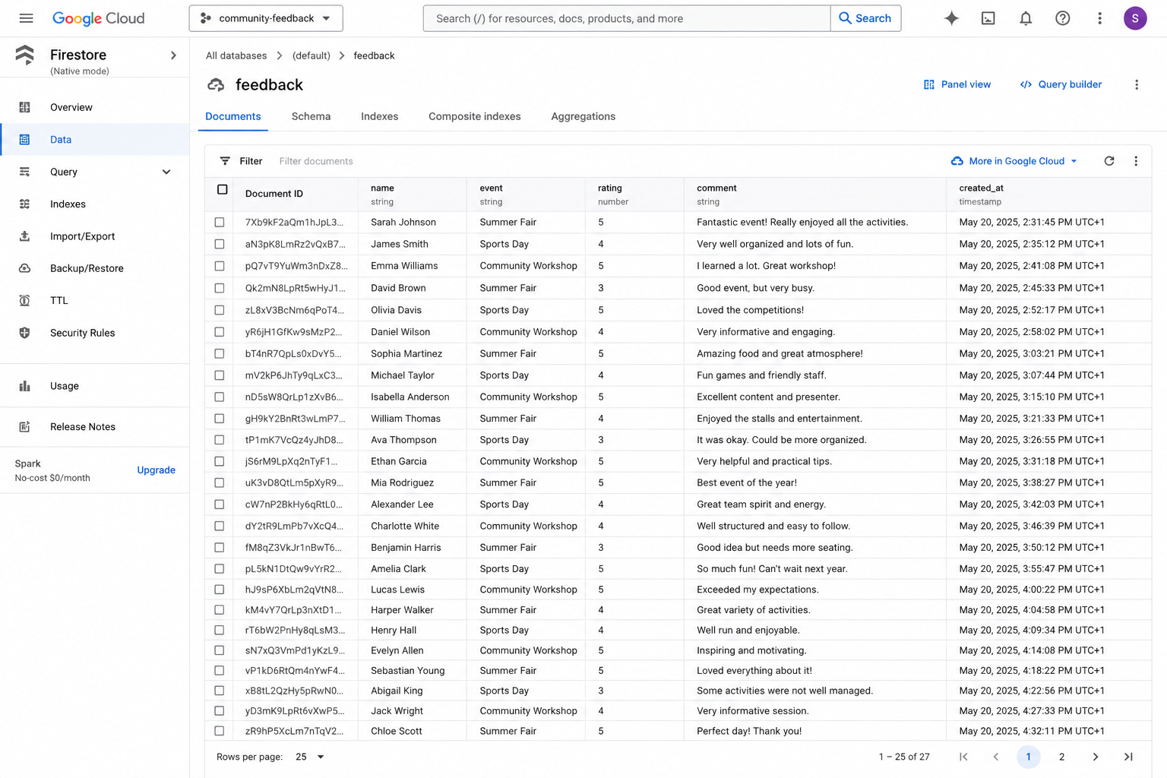
Backend
Database looks like this in Firestore.
Firestore itself is not a spreadsheet or SQL table.
It is organised as collections → documents → fields.

Slide 10
Create the Google Cloud project
01
Go to the Google Cloud Console.
02
At the top of the screen, click the project selector.
03
Click: New Project
04
Give it a name such as: community-feedback
NOTEGoogle will create a unique Project ID.

Slide 11
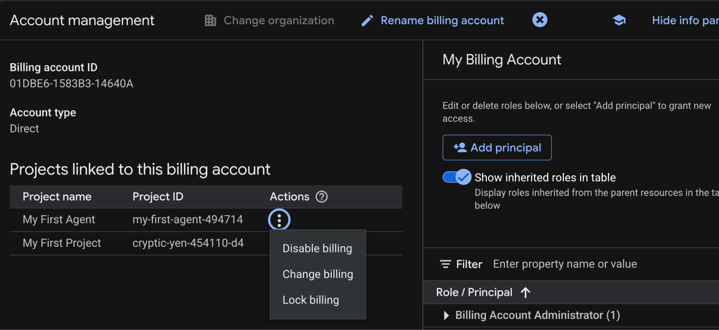
Search “Billing Account Manager” and click three dots to enable billing
Notes:
If you see “Disable billing”, it means that your billing is enabled.
No need to do anything.
If it says. “Enable Billing”, select that option.

Slide 12
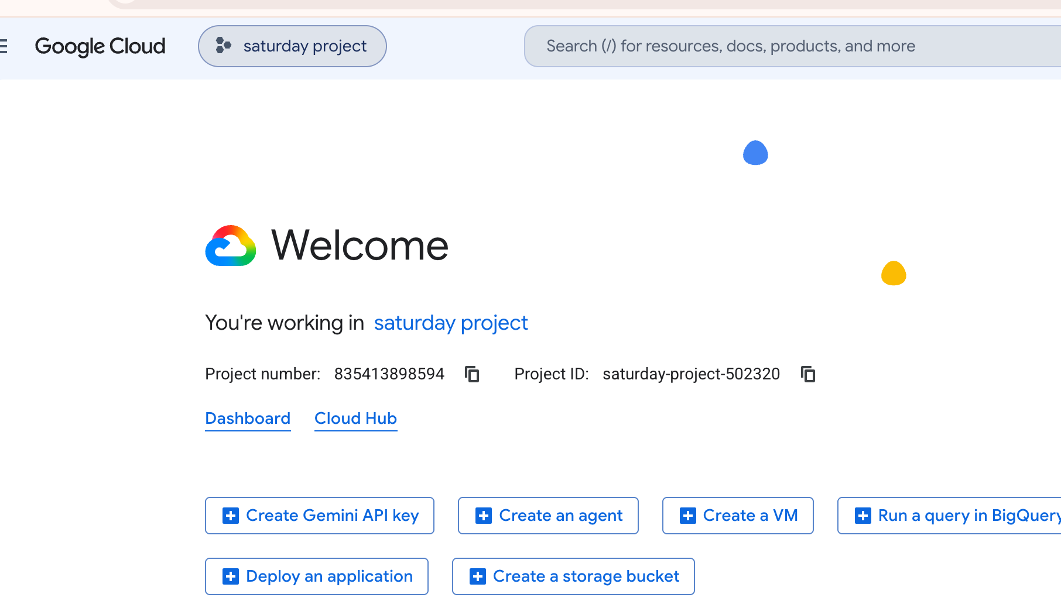
Click here

Slide 13
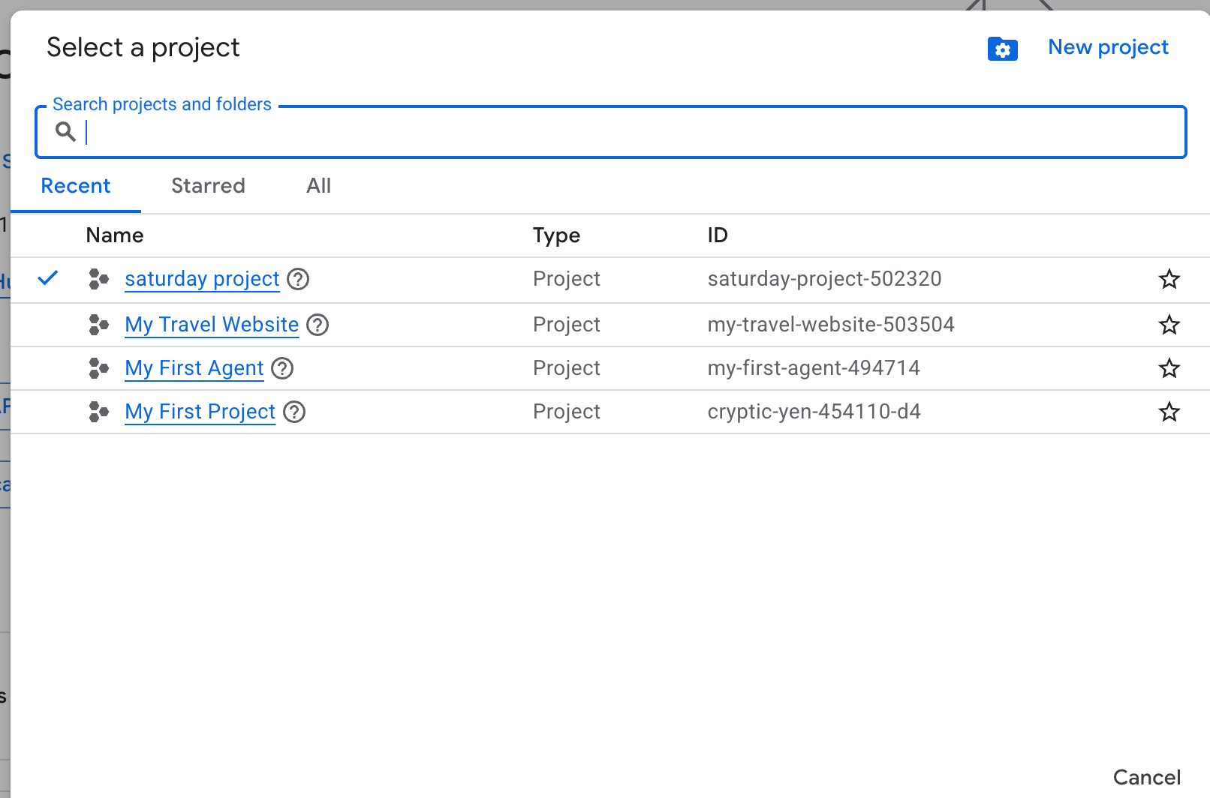
Click here

Slide 14
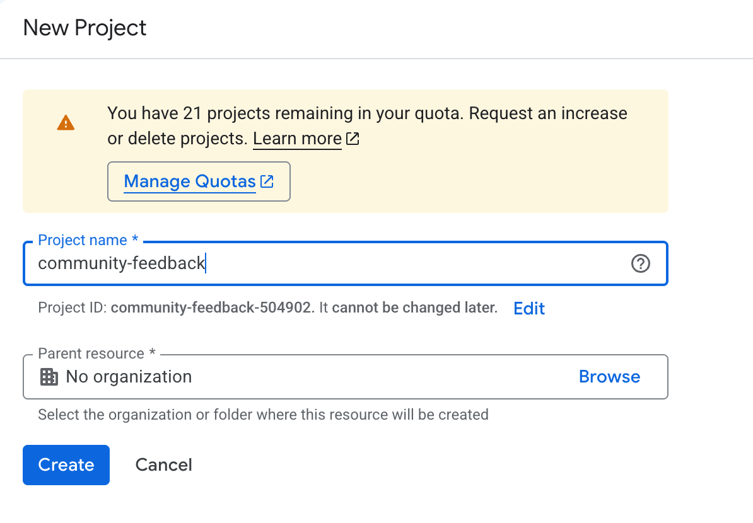
Name your project
Click here

Slide 15
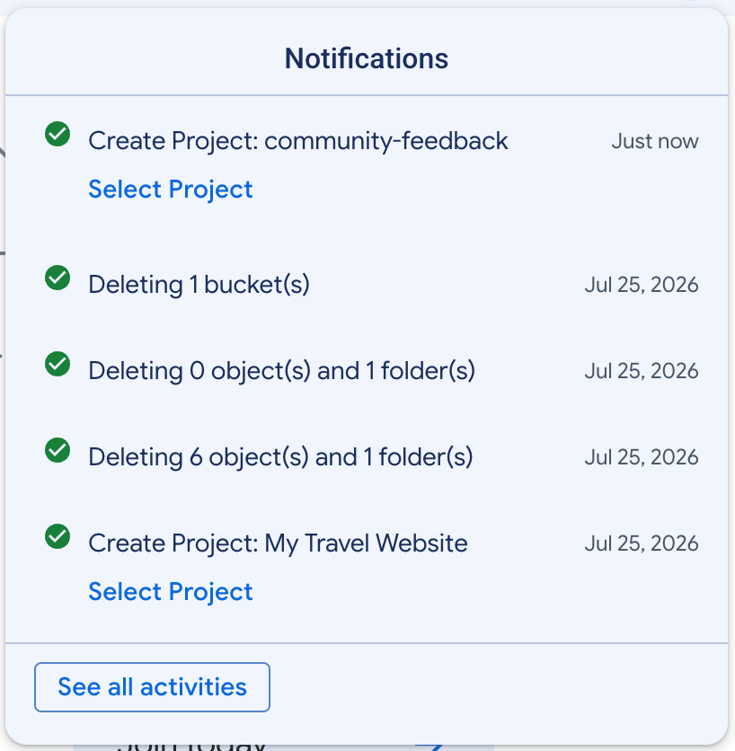
You can see a new notification.
Close the notifications by clicking the section.

Slide 16
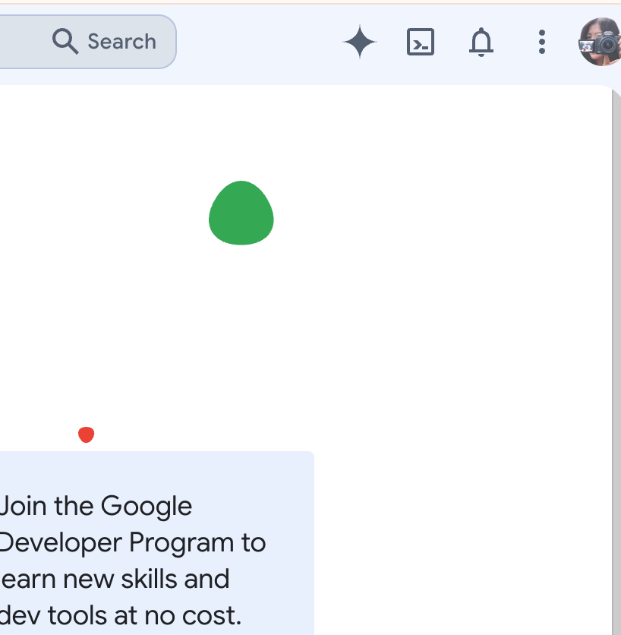
Open Cloud Shell

Slide 17
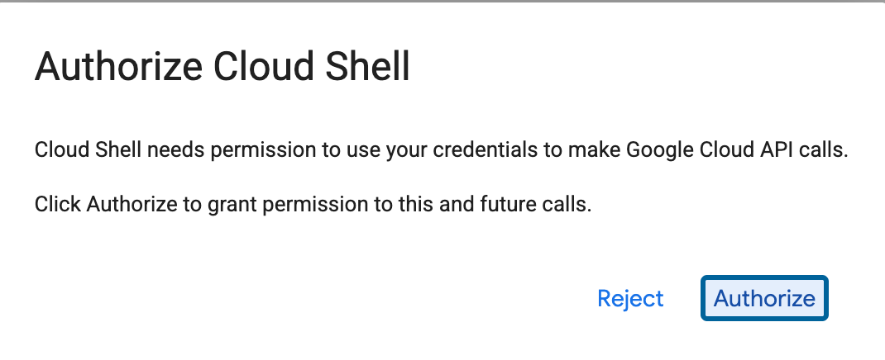
Click here

Slide 18
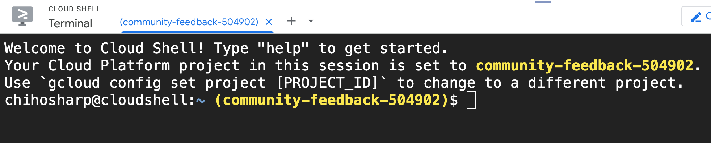
Make sure you are in the correct project.

Slide 19
2. Enable the required services
We'll use Cloud Run and Firestore.
1. Run First:
gcloud services enable run.googleapis.com
2. Then:
gcloud services enable cloudbuild.googleapis.com
3. Finally:
gcloud services enable firestore.googleapis.com

Slide 20
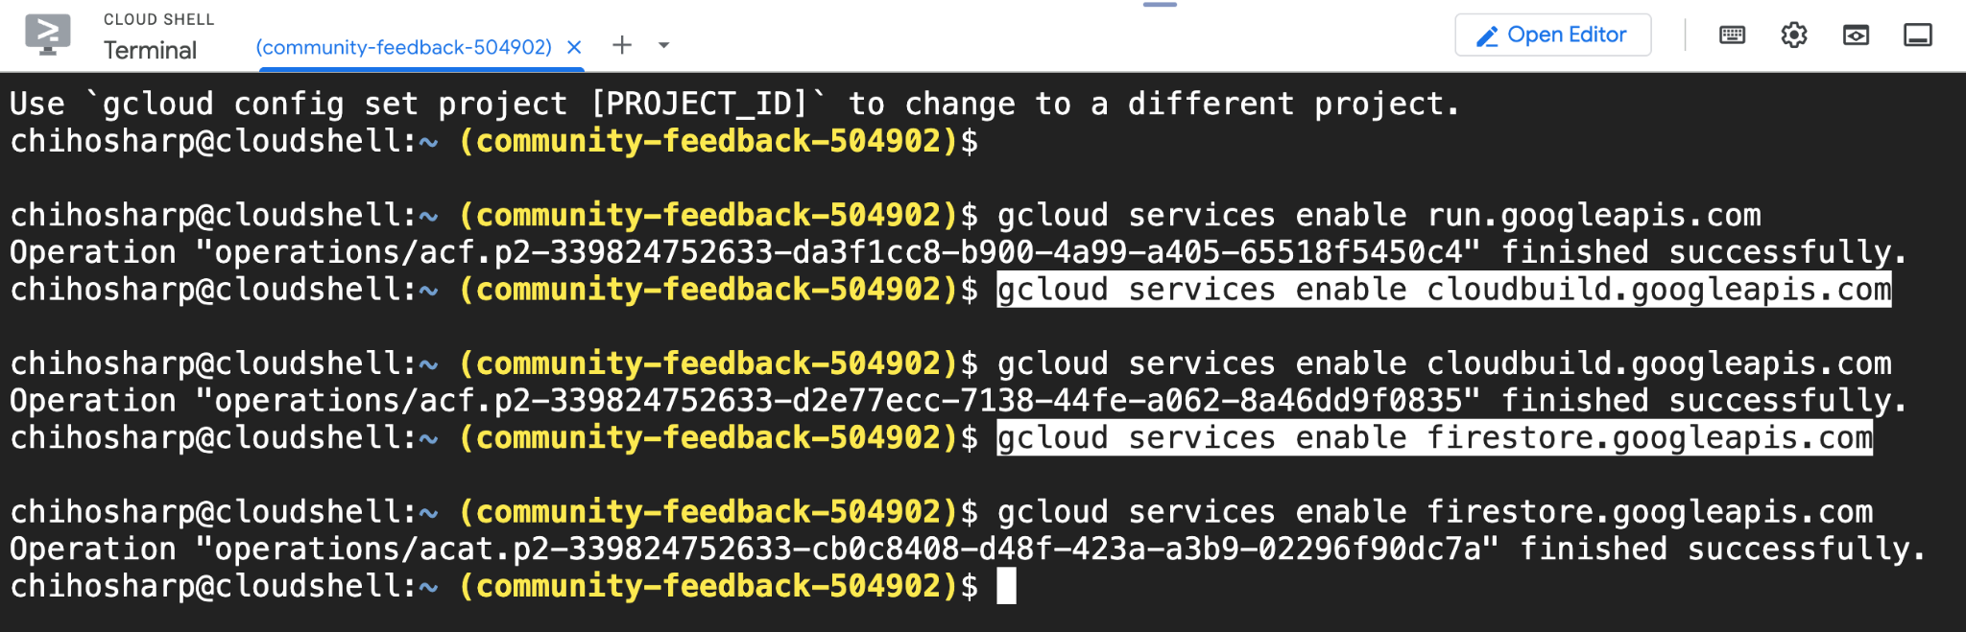
APIs/services must be enabled before an application can use them.

Slide 21

3. Create the Firestore database
STEP 01
Search Console
In the Google Cloud Console, search for: Firestore
STEP 02
Open Service
From the search results, select and open: Firestore
STEP 03
Create Database
Choose to initialize: Create a Firestore database
STEP 04
Select Mode
For this project, choose: Firestore in Native mode
IMPORTANT NOTE
Google's current Firestore setup asks you to choose the database edition, access mode and location. For Native mode, Google recommends restrictive initial security rules when you're not planning to use Firebase web/mobile SDKs.

Slide 22
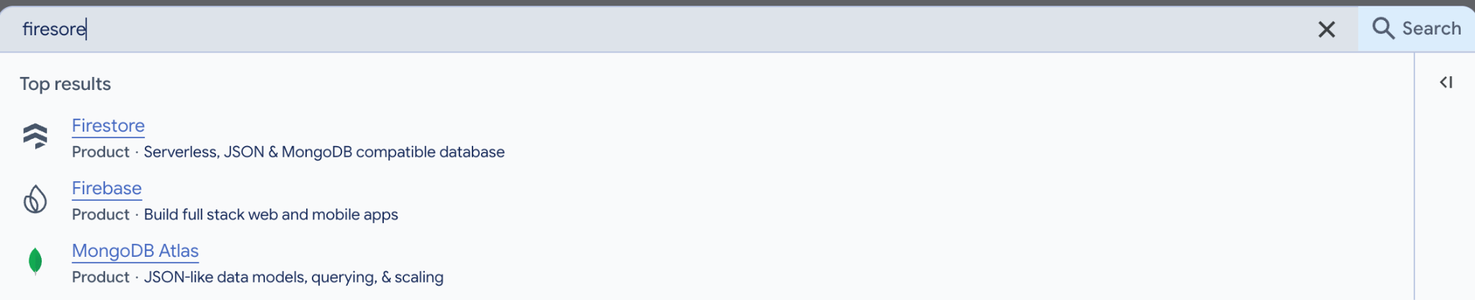
In the search bar, type “Firestore”.
Type it here
Click here

Slide 23
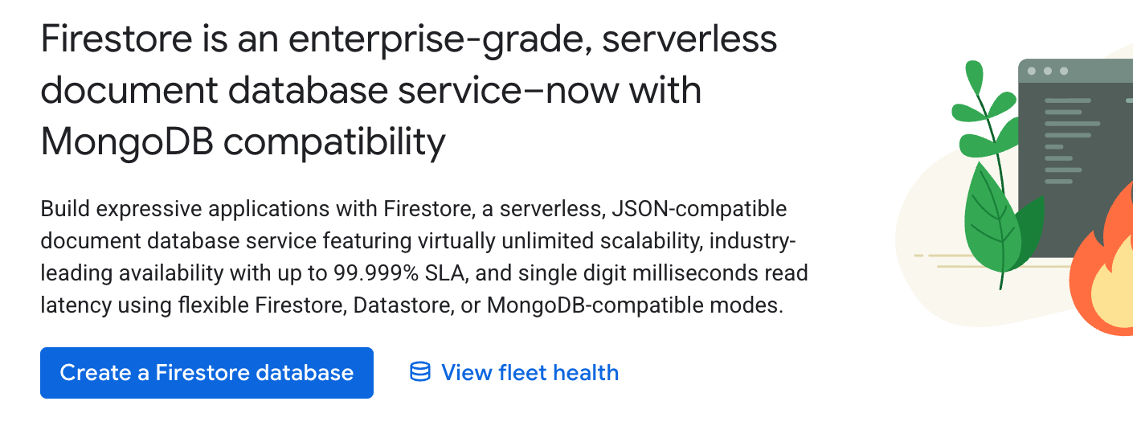
Click here

Slide 24
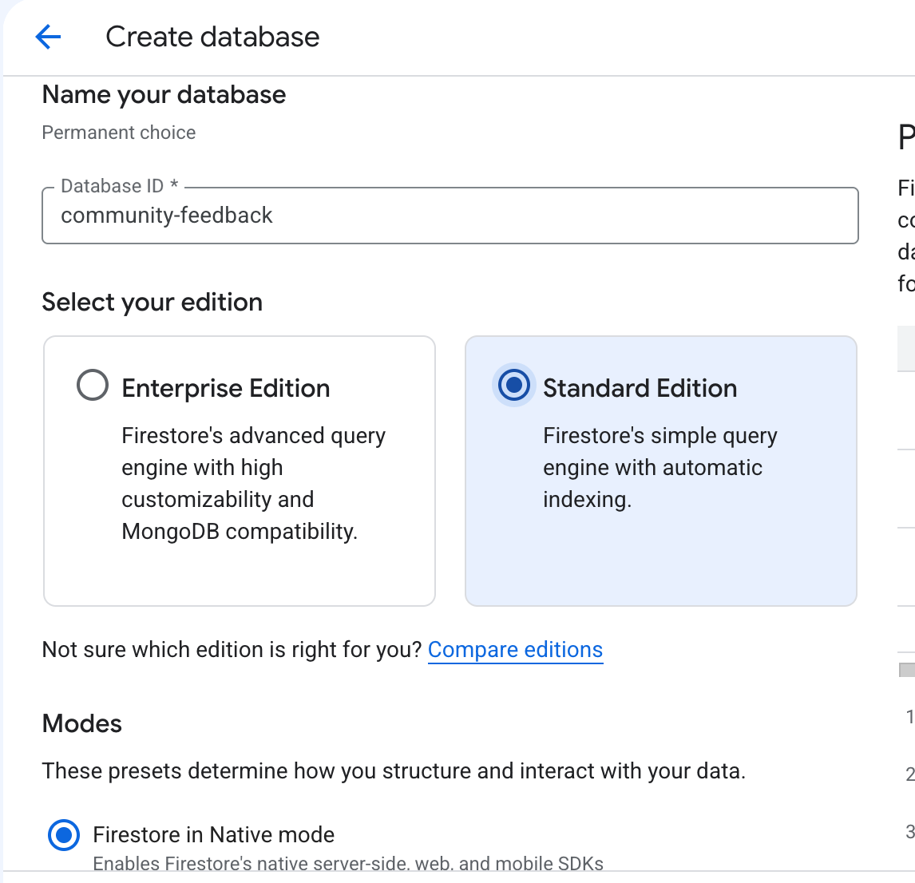
Only include letters, numbers, and hyphen (-) characters.
Letters must be lowercase.
The first character must be a letter.
The last character must be a letter or number.
Minimum of 4 characters.
Maximum of 63 characters.
Must not be a UUID or resemble a UUID. For example, don't use an ID like f47ac10b-58cc-0372-8567-0e02b2c3d479.
Select this

Slide 25
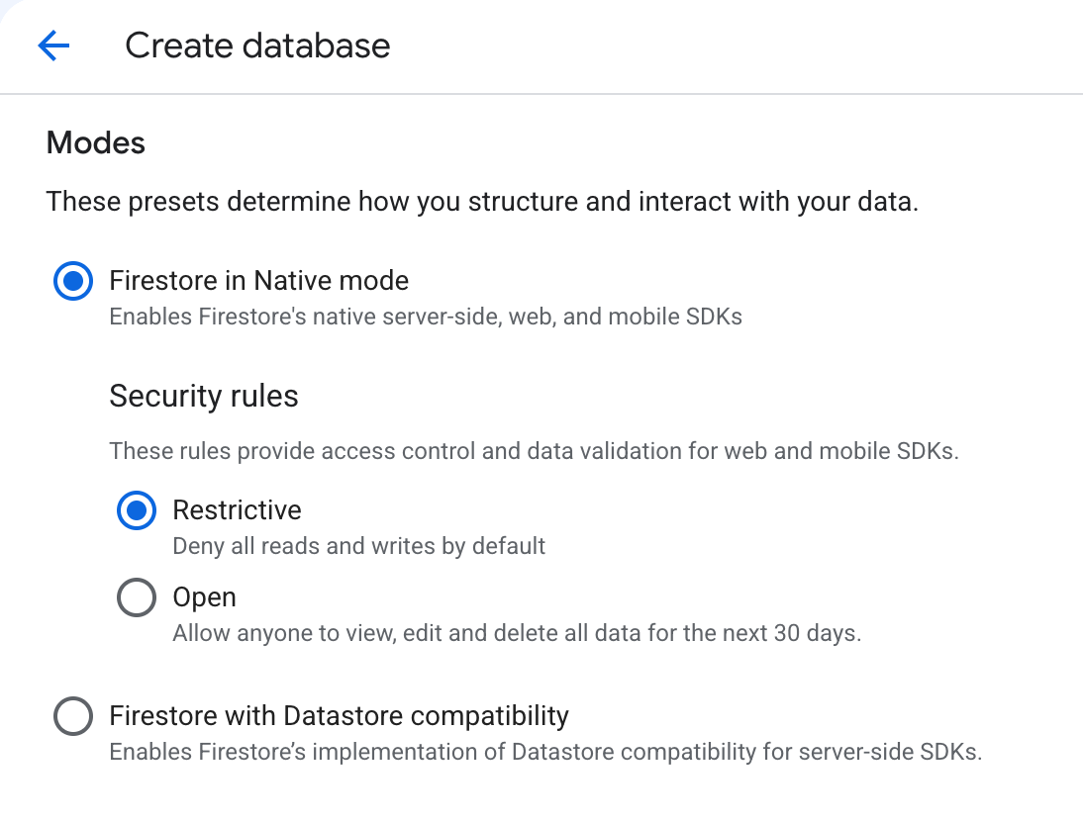
**For Native mode, Google recommends restrictive initial security rules when you're not planning to use Firebase web/mobile SDKs.

Slide 26
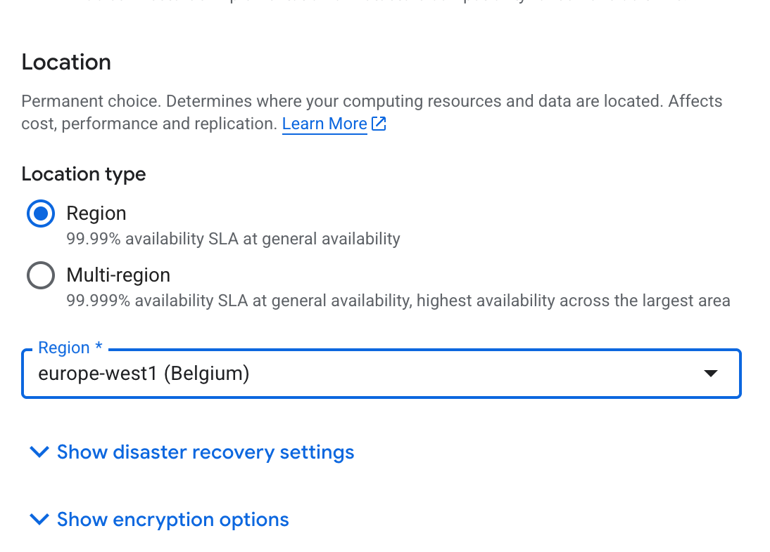
Compare the price. London is more expensive.
Choose an appropriate location close to your intended users.
For example, if tit’s a UK application, you could choose a European region.

Slide 27
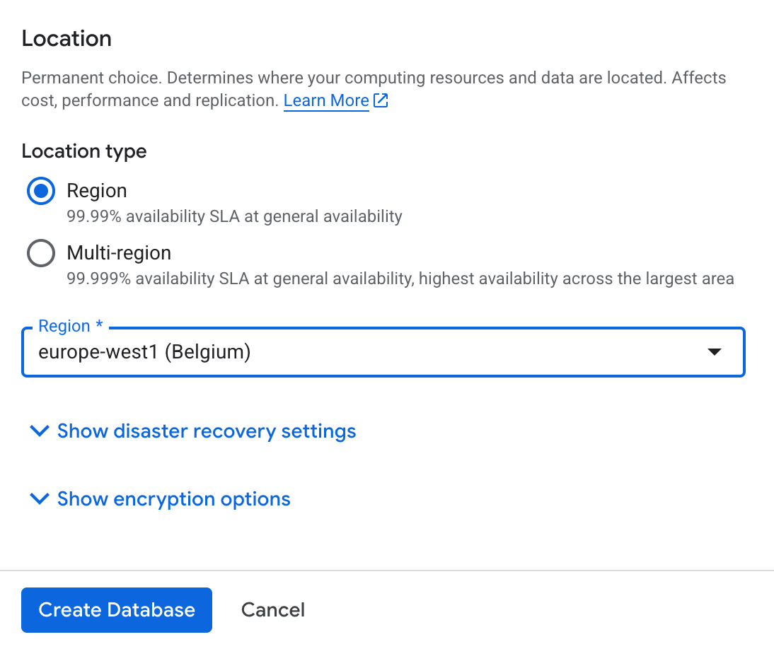
Click to create

Slide 28
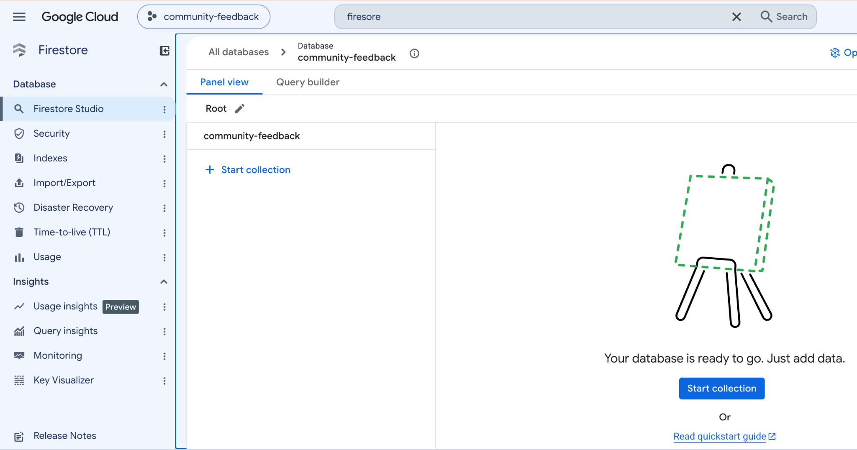

Slide 29
4. Create the application folder
Step 01
Access Terminal
Go back to Cloud Shell to begin setting up your environment.
terminalCloud Shell Active
Step 02
Create Directory
Run the command to create the workspace folder:
$ mkdir community-feedback
Step 03
Enter & Verify
Change directory and check your location:
$ cd community-feedback
$ pwd
pwd means “print working directory.” It is a simple terminal command that tells you which folder you are currently working in.

Slide 30
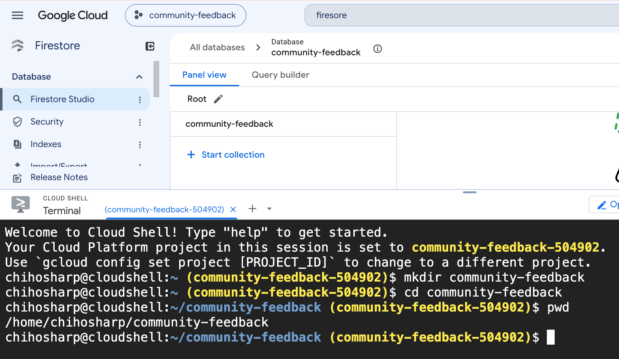

Slide 31
5. Create the Python application
Step 01
Create File
Create the main file in your workspace directory:
$ touch main.py
Step 02
Open Editor
Open the file in Cloud Shell. You can click:
Open Editor
from Cloud Shell.
Step 03
Verify Structure
Your folder structure should look like this:
community-feedback/
└── main.py
We will use Python + Flask to build the application.

Slide 32
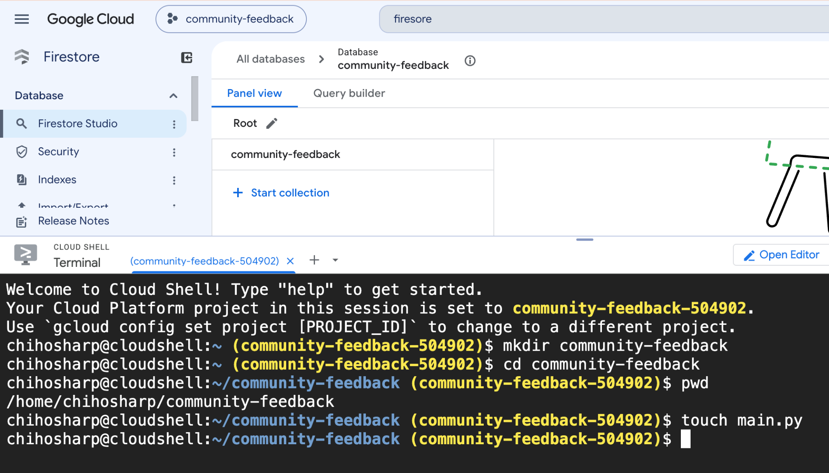

Slide 33
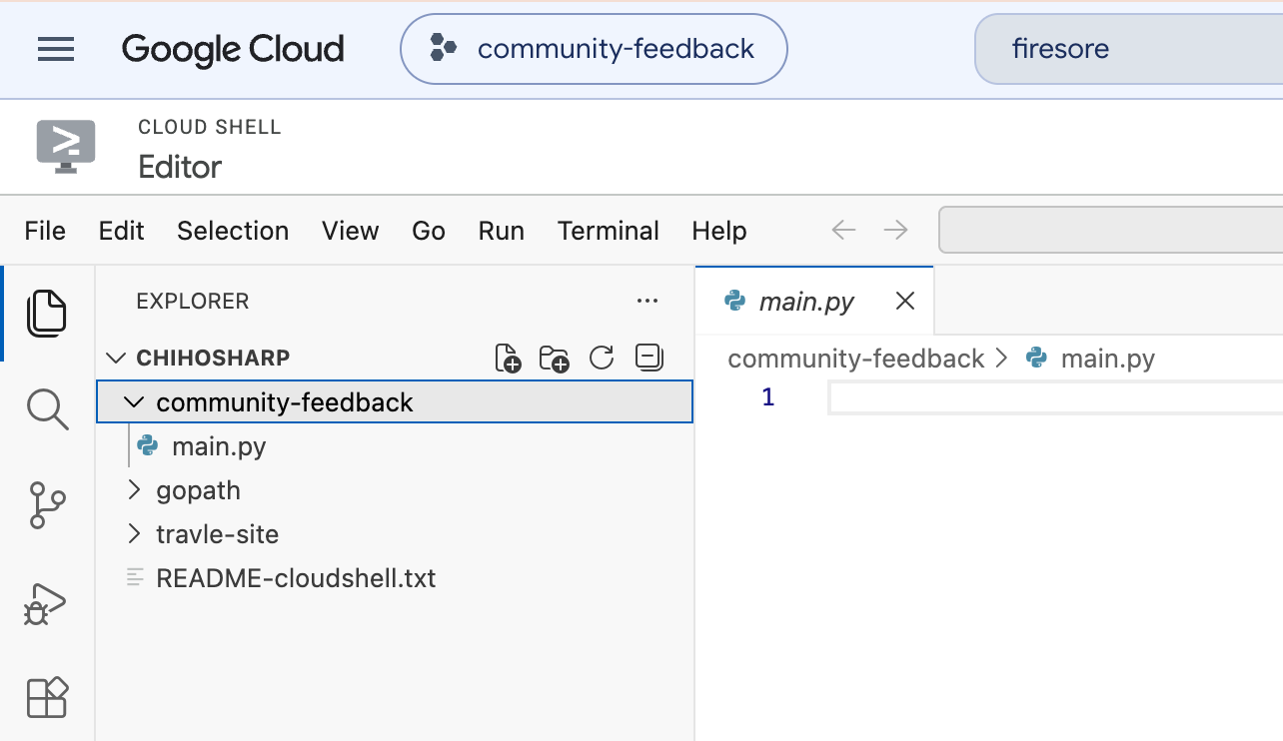

Slide 34

Get Started: Copy the Starter Code
Download the required Python templates to begin building your community application.
description
main.py
The central script for your web service. It initialises the Flask application and handles direct communications with your Firestore database.
cloud_download
Source File Download
Access the complete project files and configurations stored securely on Google Drive:
https://drive.google.com/file/d/1mTnTEEIGxJpn3vBvoK8MHs9x4wdJw9vu/view?usp=drive_link
Notes:
main.py: https://drive.google.com/file/d/1mTnTEEIGxJpn3vBvoK8MHs9x4wdJw9vu/view?usp=drive_link

Slide 35
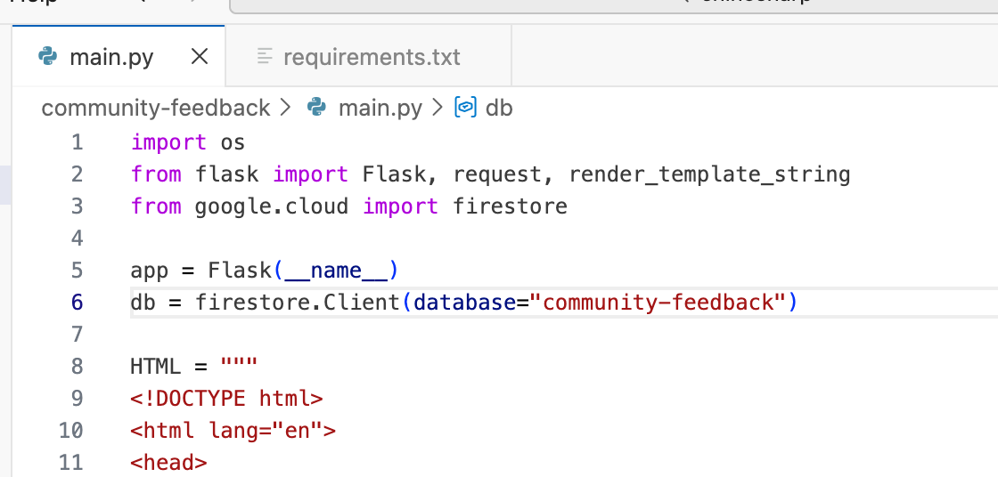
( ) = Default database
Change it to the name of your database

Slide 36
How Python Communicates with Firestore
Step 1: Initialise Client
The important line is:
db = firestore.Client()
"This creates a connection between our Python application and Firestore."
Step 2: Save Feedback
Then:
db.collection("feedback").add(feedback_data)
Means:
"Take the feedback and save it in the feedback collection."

Slide 37
Architecture
STEP 01
HTML Form
Frontend interface where users enter names, ratings, and comments.
STEP 02
Flask App
Web server routing incoming POST requests from the client web browser.
STEP 03
Python Code
Backend logic initializing the Firestore client and processing user data.
STEP 04
Firestore
Serverless NoSQL database storing feedback as persistent cloud documents.

Slide 38
6. Create requirements.txt
Add Dependencies
Create a requirements.txt file and define the required packages:
Flask==3.1.3
google-cloud-firestore
gunicorn
Project Structure
Your directory layout should now look like this:
community-feedback/
├── main.py
└── requirements.txt
Note: Google's current Cloud Run Python quickstart uses Flask and supports source deployment through buildpacks.
Notes:
That's all the source code we need

Slide 39
7. Deploy to Cloud Run
From inside the community-feedback directory,
run:
gcloud run deploy community-feedback \
--source . \
--region europe-west1 \
--allow-unauthenticated
Notes:
Google Cloud's current Cloud Run source deployment supports gcloud run deploy --source, automatically building the source without students needing to create a Dockerfile themselves.
https://docs.cloud.google.com/run/docs/deploying-source-code?authuser=0&utm_source=chatgpt.com

Slide 40
What will happen?
STEP 01
code
Your Code
Push local application files to the cloud.
STEP 02
construction
Cloud Build
Compile code and construct environment.
STEP 03
layers
Container
Package image stored in registry.
STEP 04
cloud_queue
Cloud Run
Deploy container automatically.
STEP 05
link
Public URL
Service goes live with HTTPS endpoint.
arrow_forward
arrow_forward
arrow_forward
arrow_forward
"We wrote Python code, but we didn't create a virtual machine."
Cloud Run manages the infrastructure required to run the application. This is a serverless concept.

Slide 41
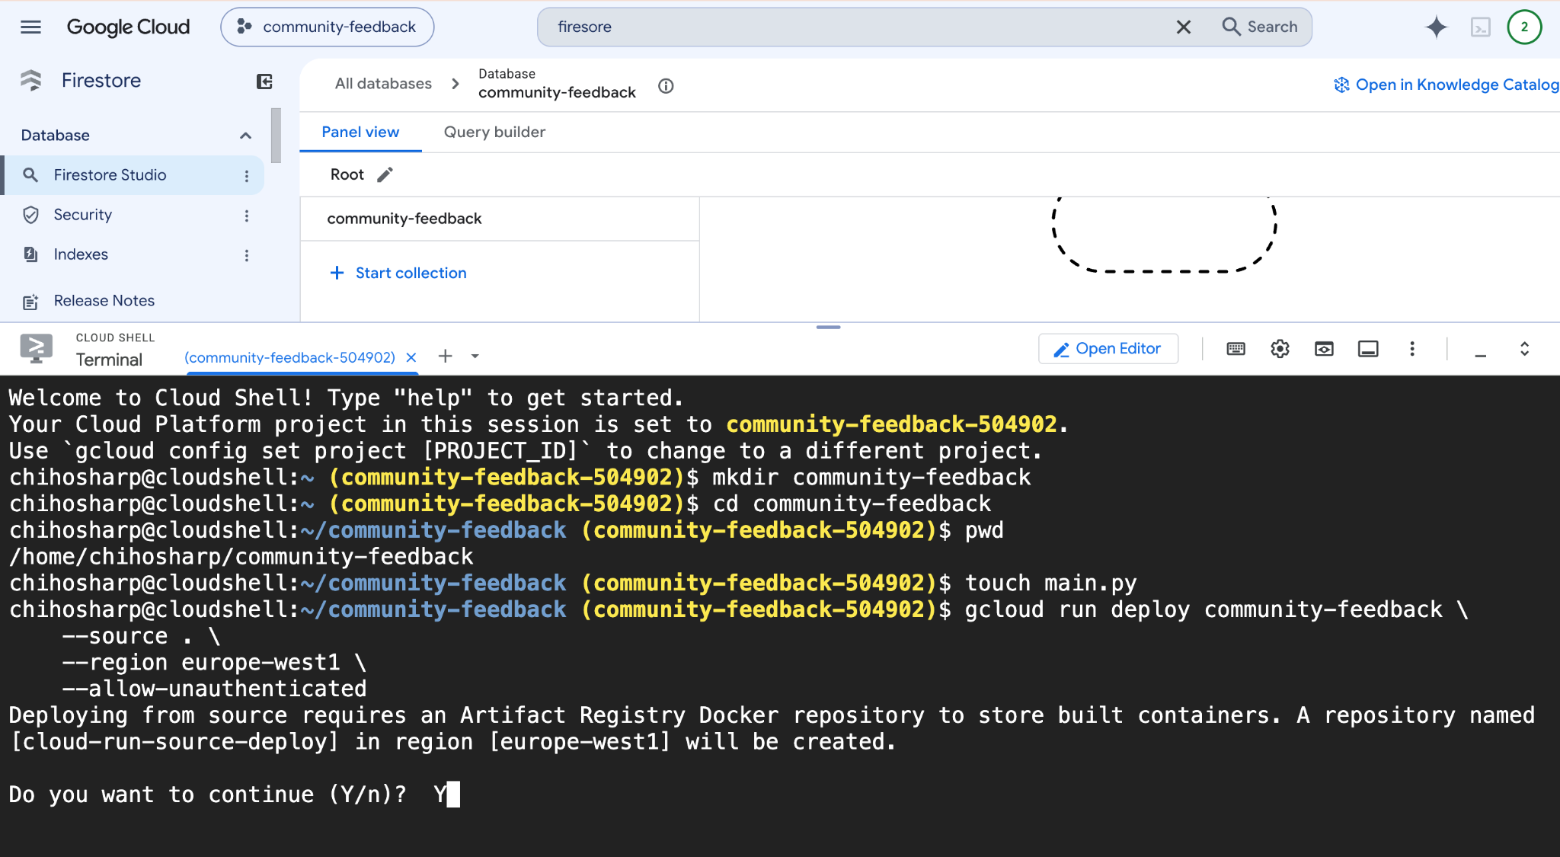

Slide 42
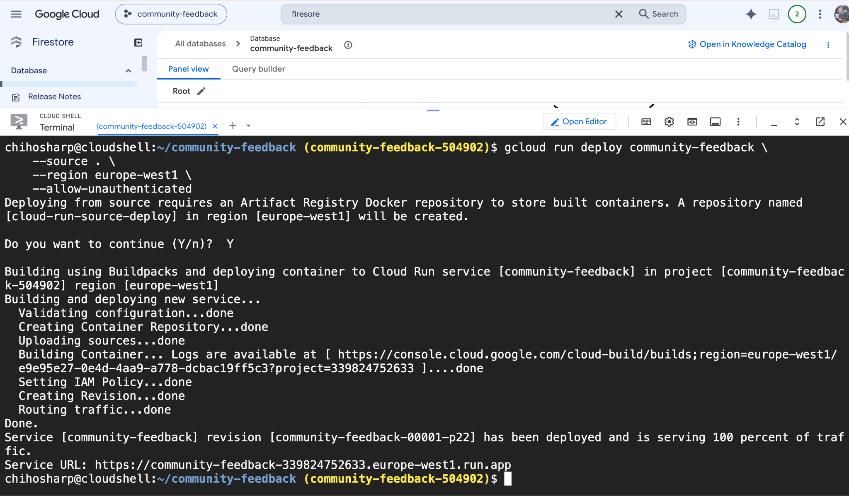

Slide 43
8. Allow public access
During deployment, Cloud Run may ask: Allow unauthenticated invocations?
Choose: Yes
This means: Anyone with the URL can access the web application.
It does not mean: Anyone can directly access the Firestore database.
The application is publicly accessible, while Firestore is accessed by the application's server-side identity.
This is an important architecture/security distinction.

Slide 44
9. Open the application
At the end of deployment, Google Cloud will give students a URL similar to:
https://community-feedback-xxxxx-uc.a.run.app
Click it.

Slide 45
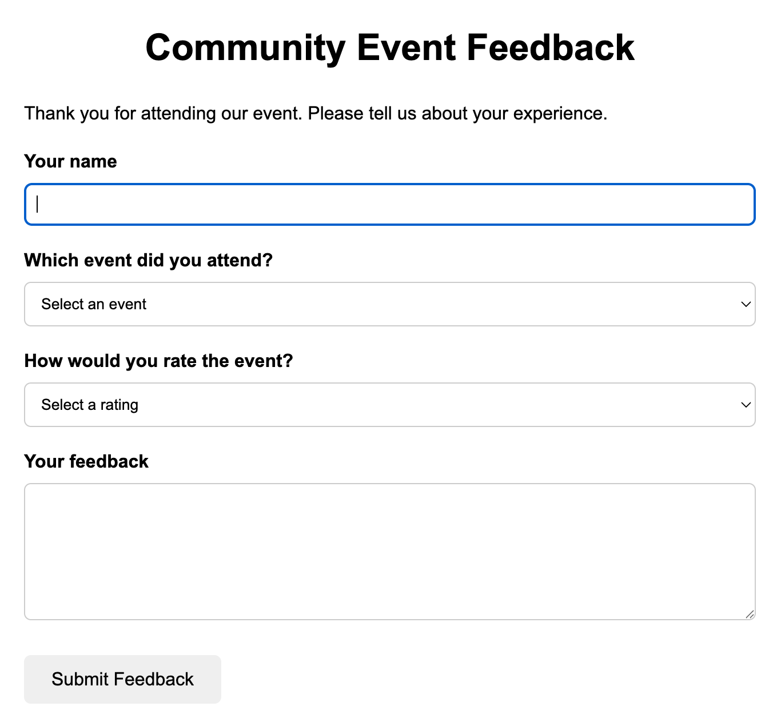

Slide 46
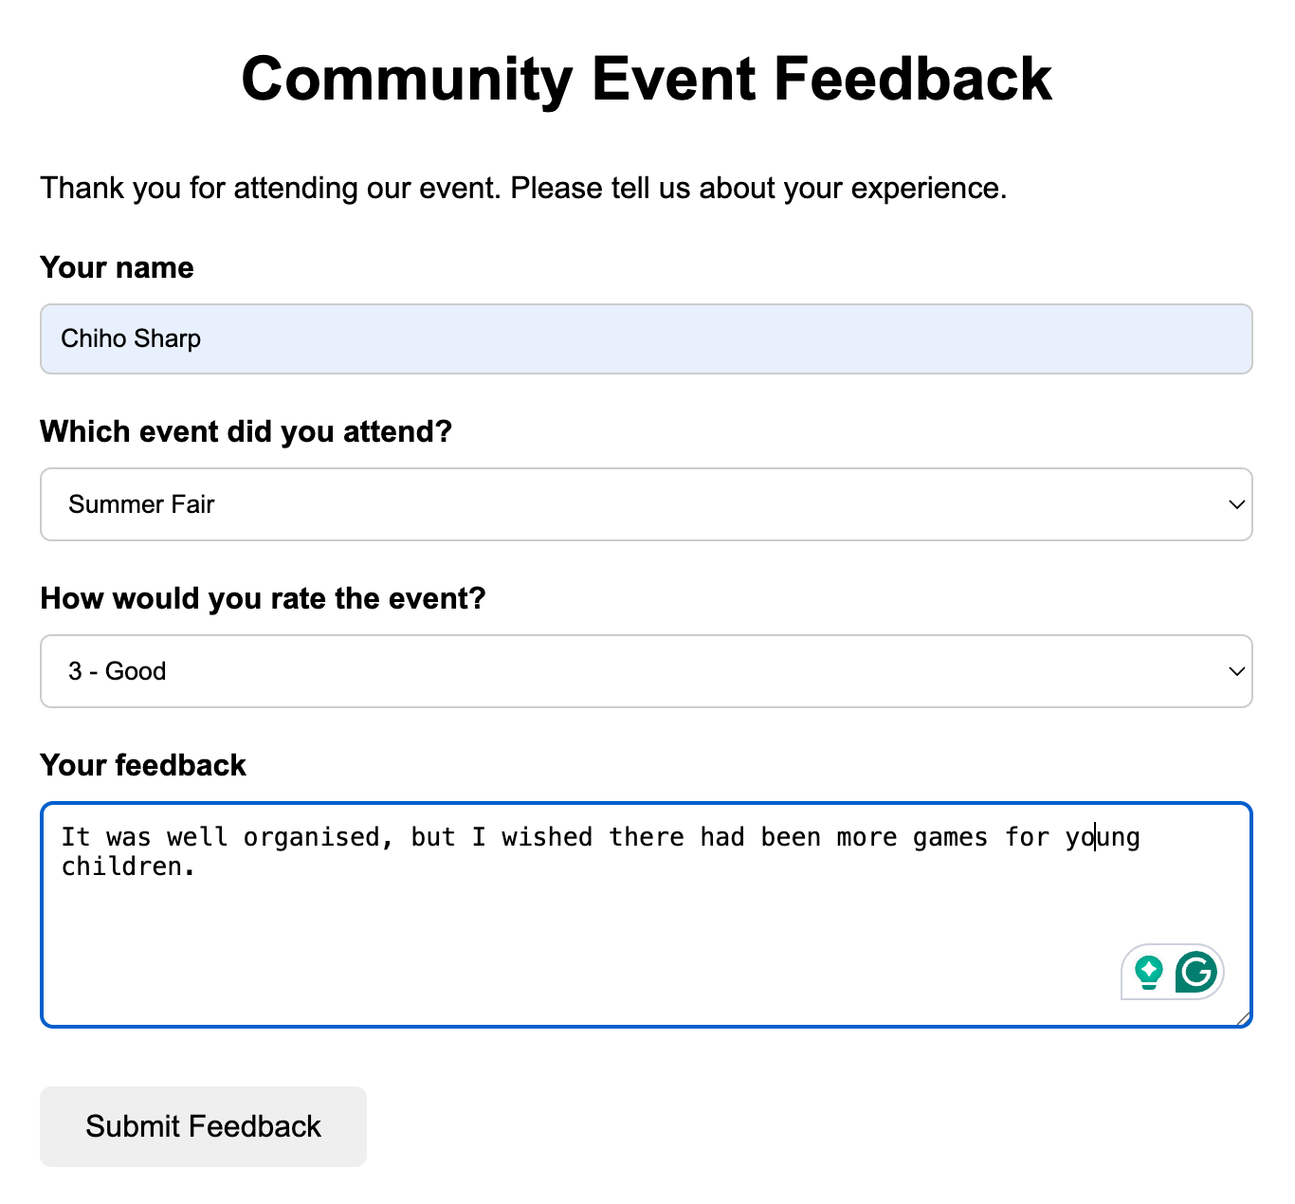

Slide 47
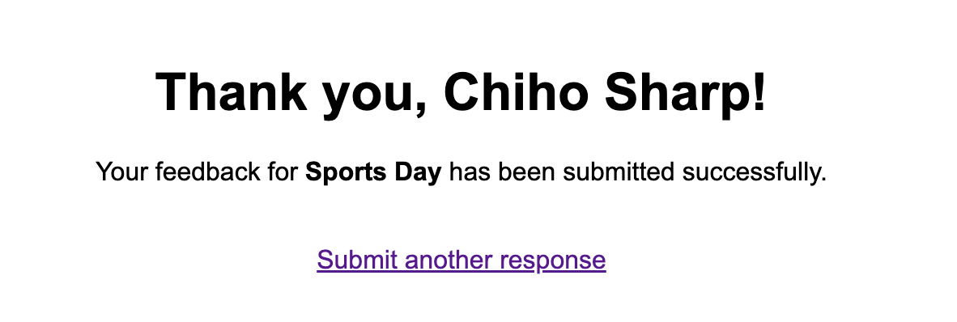

Slide 48
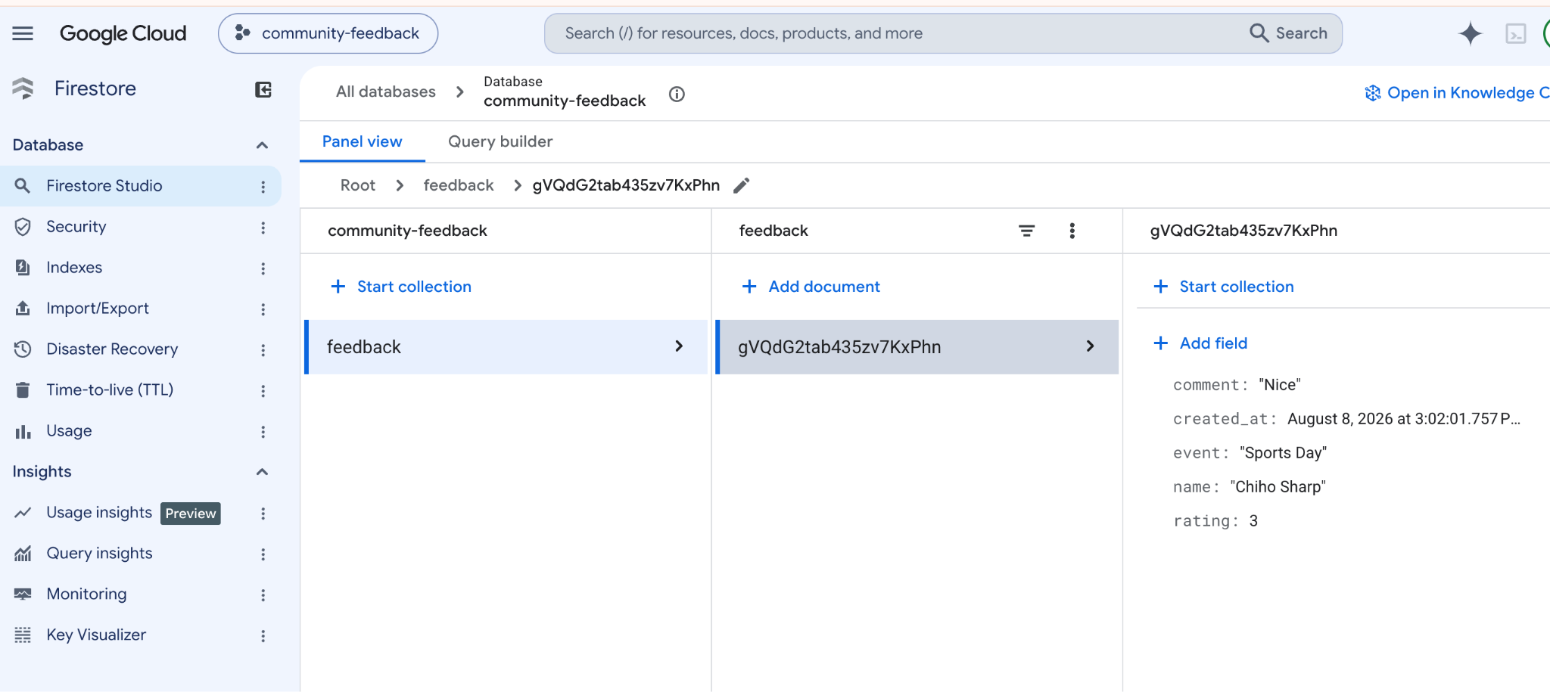
This is what my response looks like in Firestore Database.

Slide 49
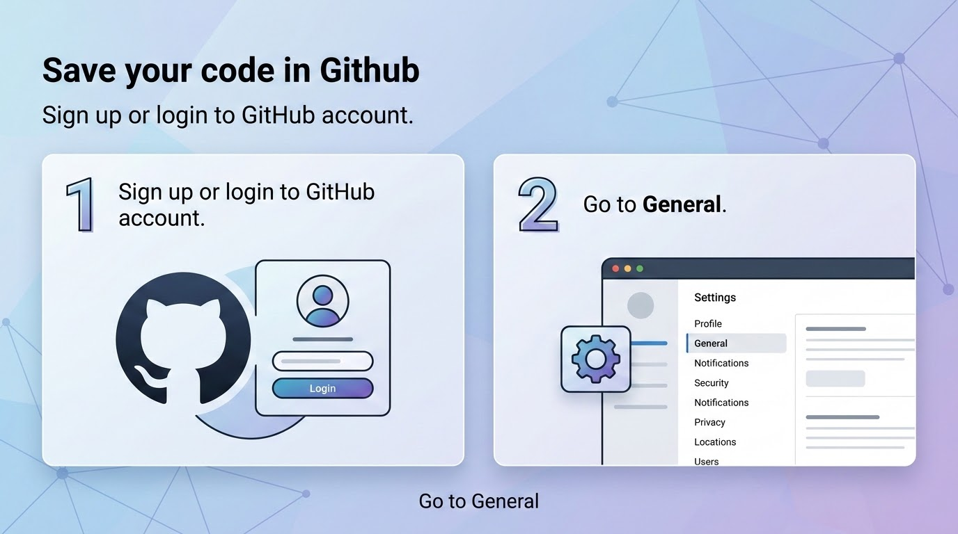
Save your code in Github
Sign up or login to GitHub account
Go to General

Slide 50
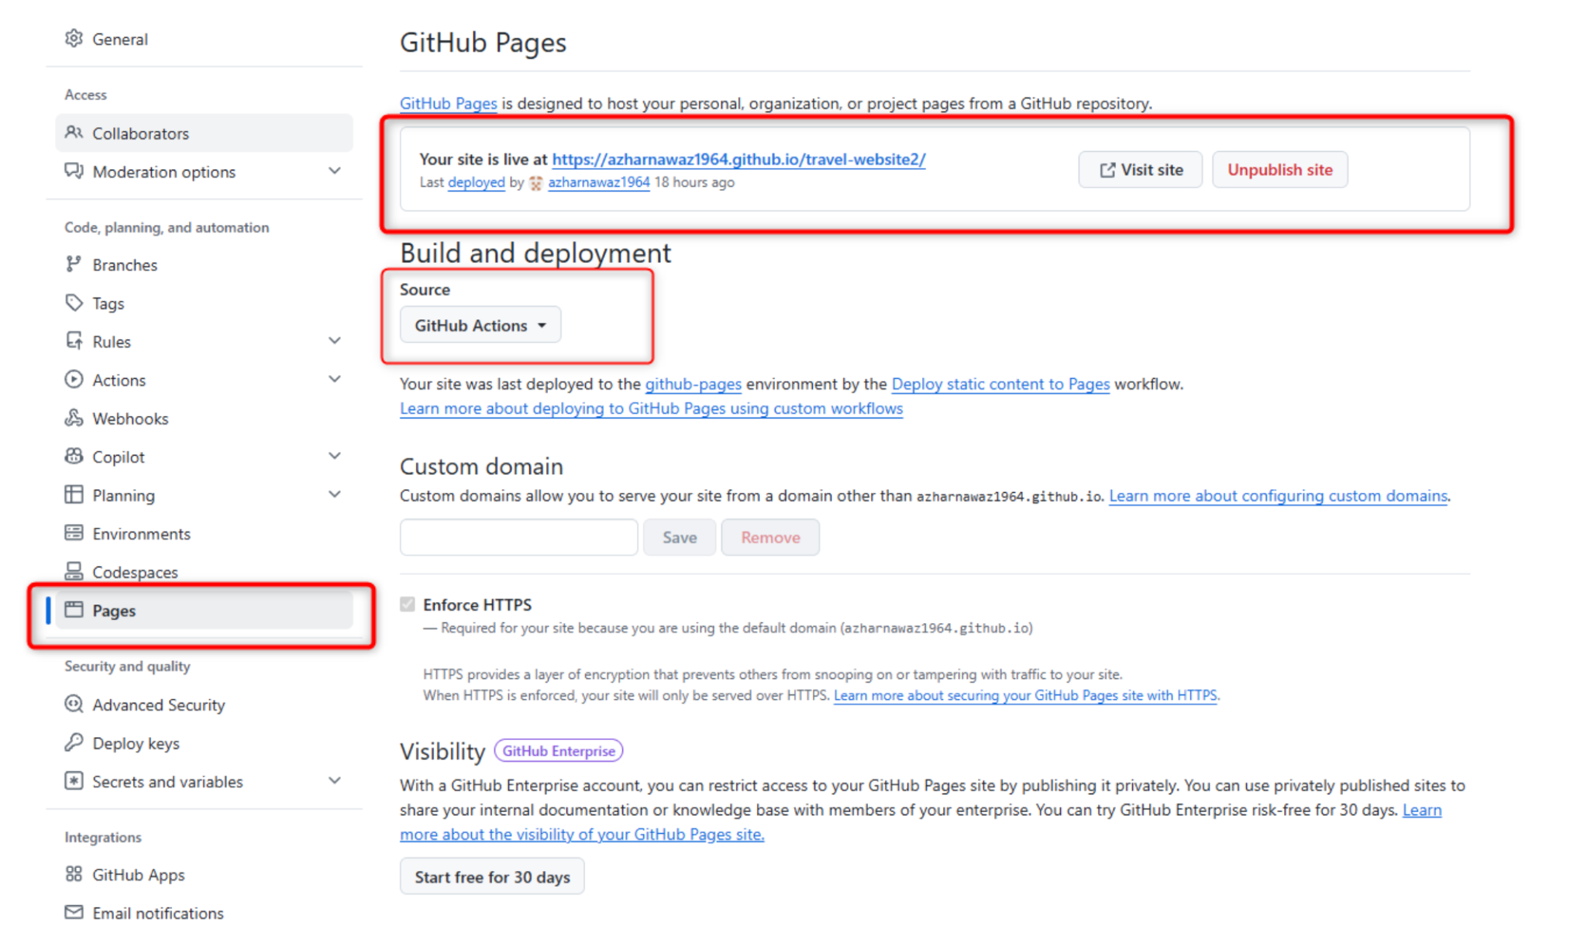

Slide 51
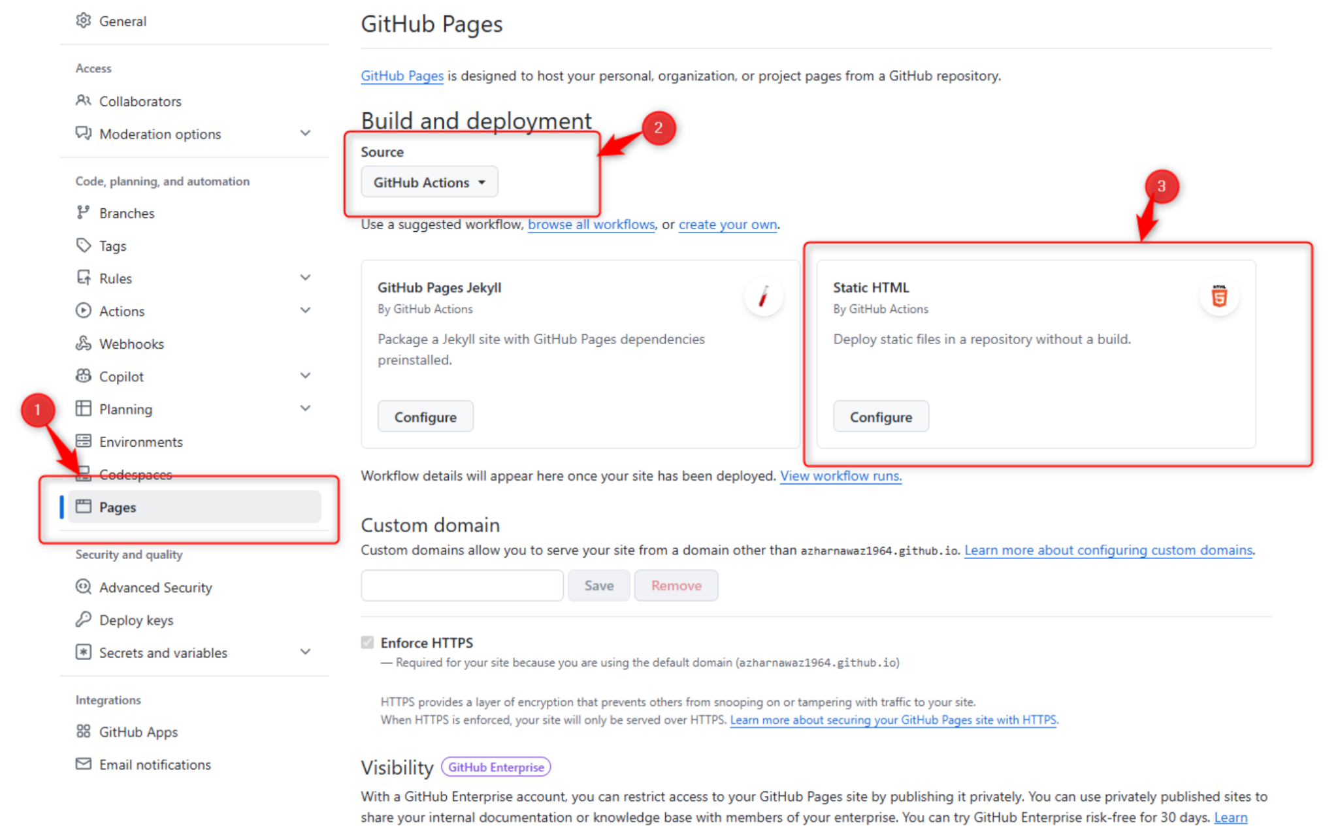

Slide 52
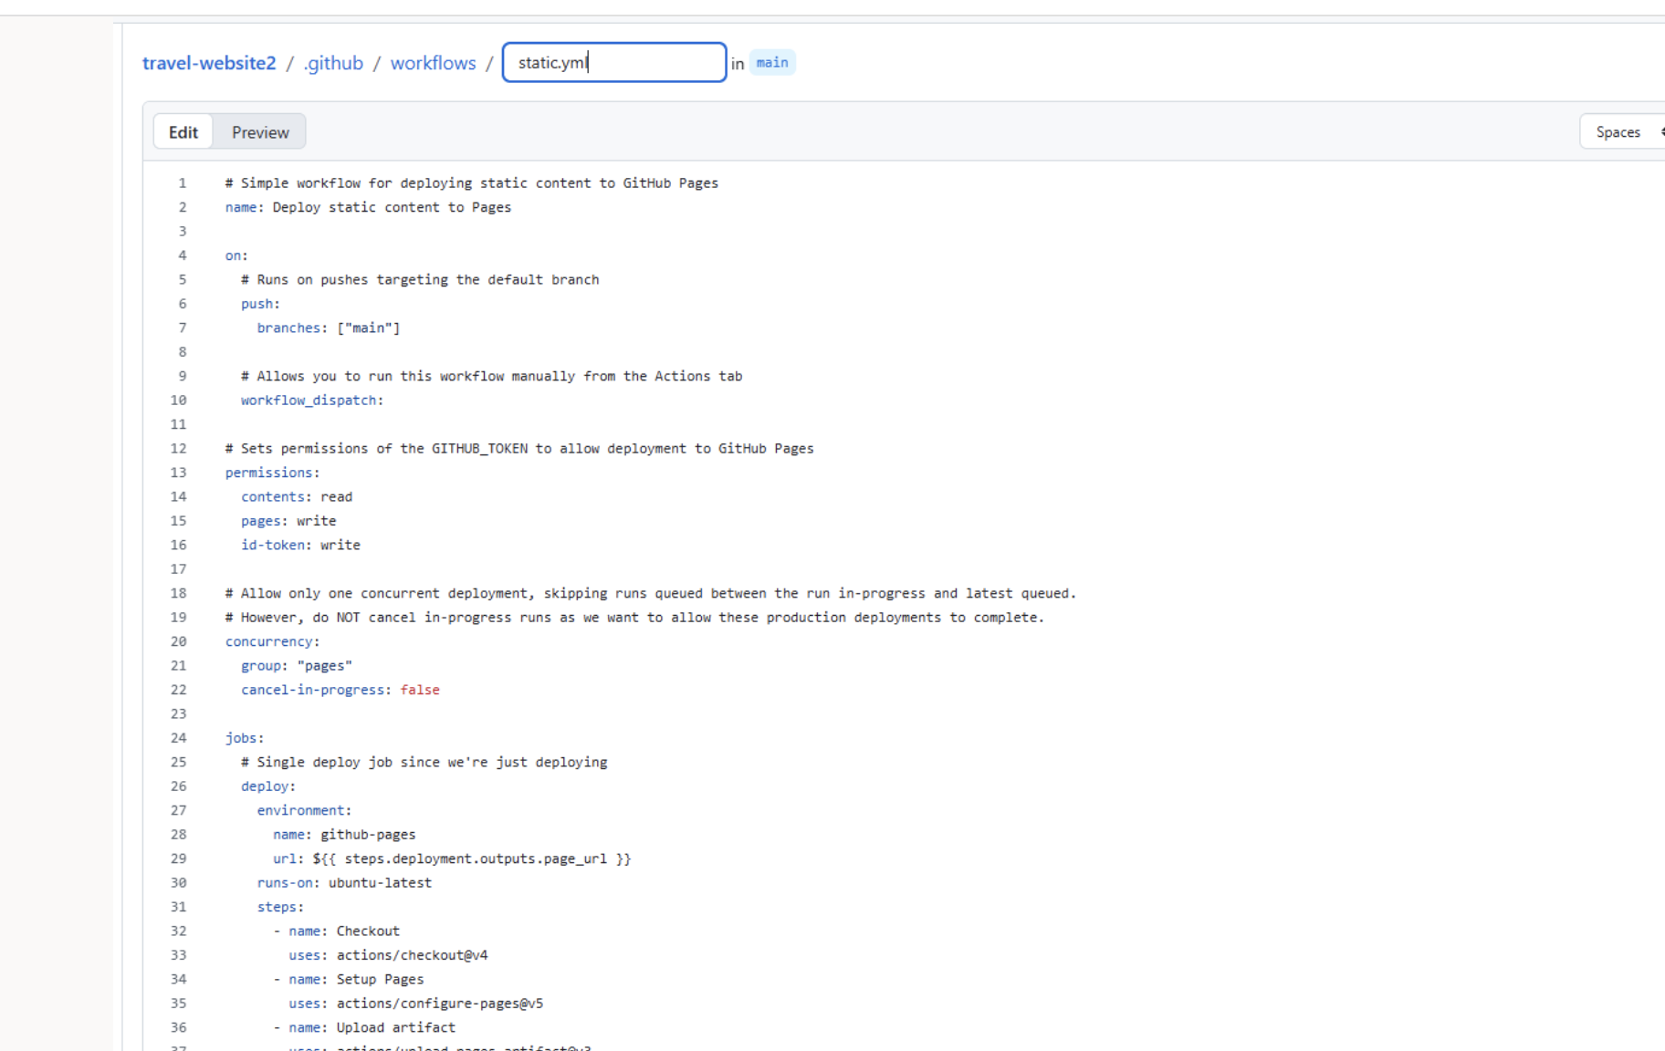

Slide 53
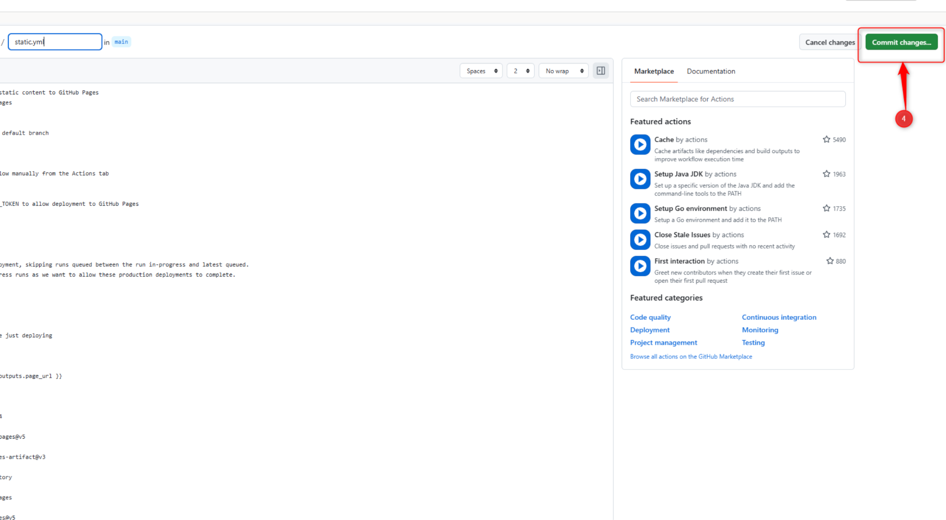

Slide 54
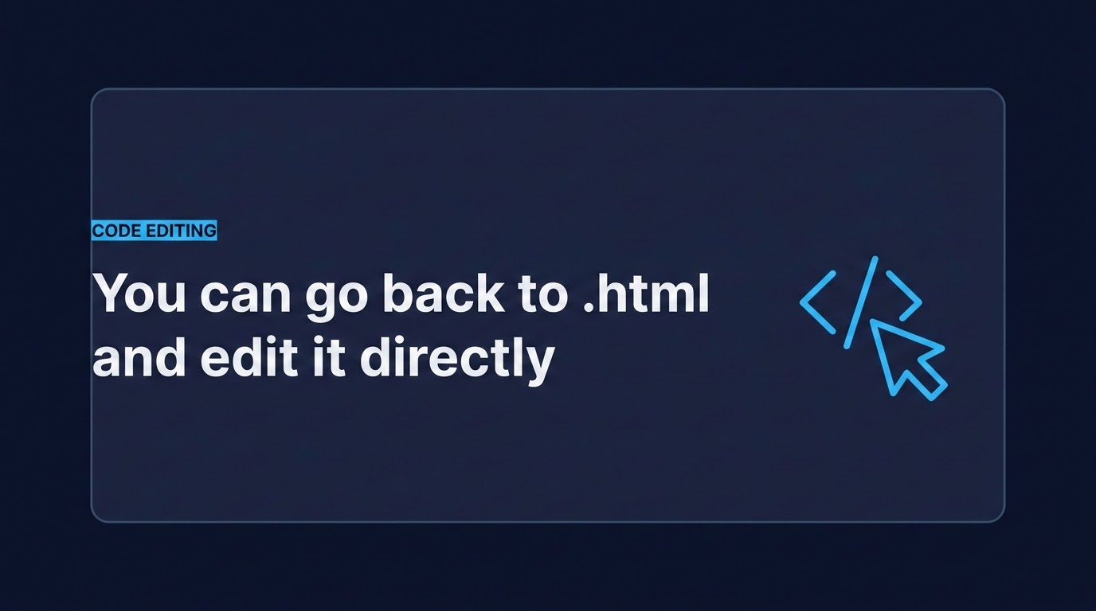
You can go back to .html and edit it directly

Slide 55

CLOUD PRINCIPLE
Stop and delete Unused Resources and projects
One of the most critical cloud optimisation principles is shutting down idle assets to actively prevent billing leaks.
power_settings_new

Slide 56
SUCCESS
Project Completed!
Congratulations

Slide 57
QUESTIONS
Any questions?
Thank you for your time. Feel free to ask anything
or share your thoughts.

